Slide 1

Rhino Vibe Coding
Dennis Shelden, Ph.D.
Associate Professor CASE / RPI

Slide 2
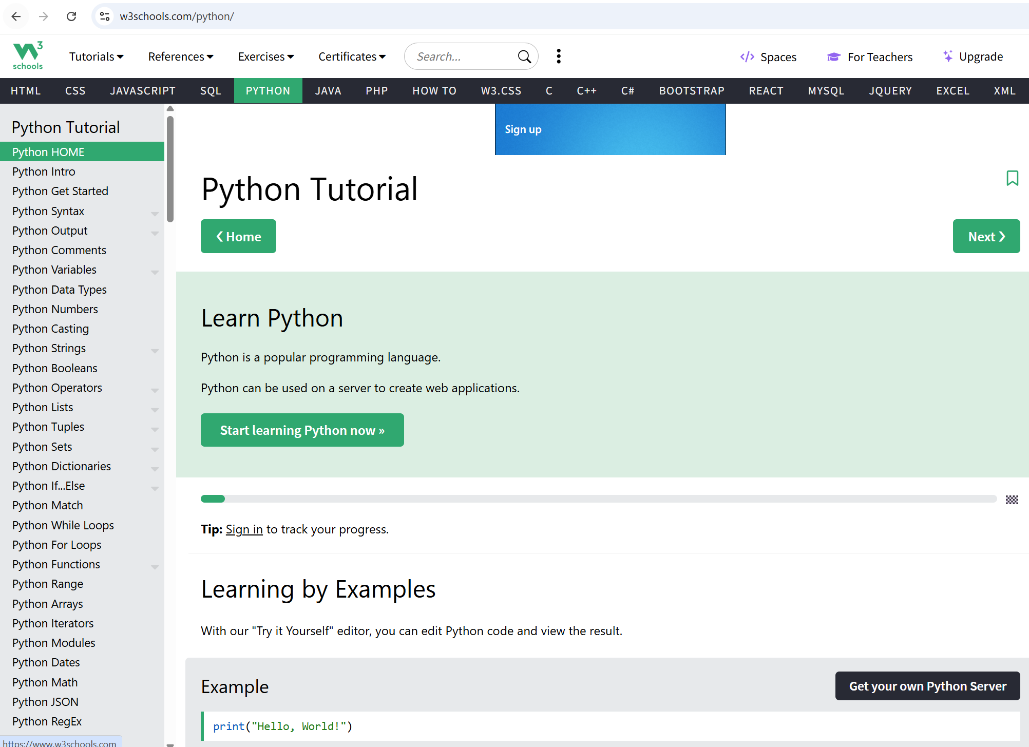
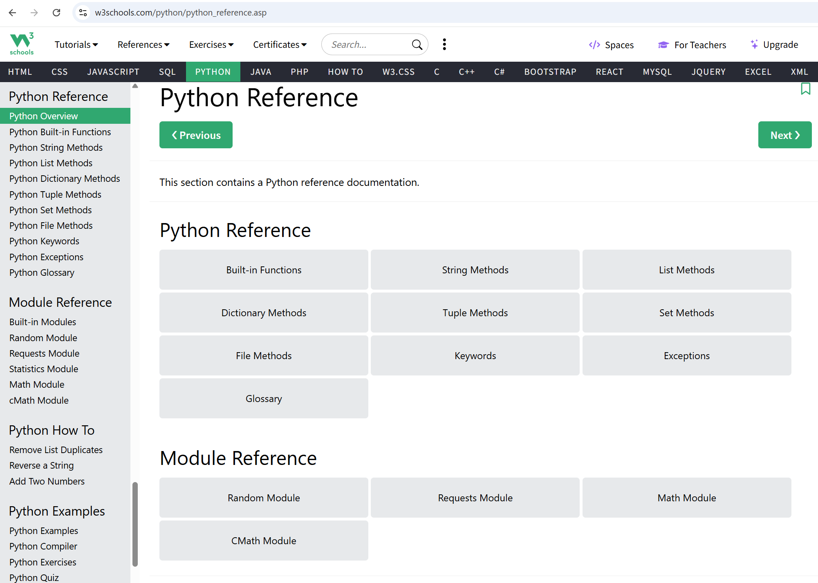
General resources: Learn Python
https://www.w3schools.com/python/
https://www.w3schools.com/python/python_reference.asp

Slide 3
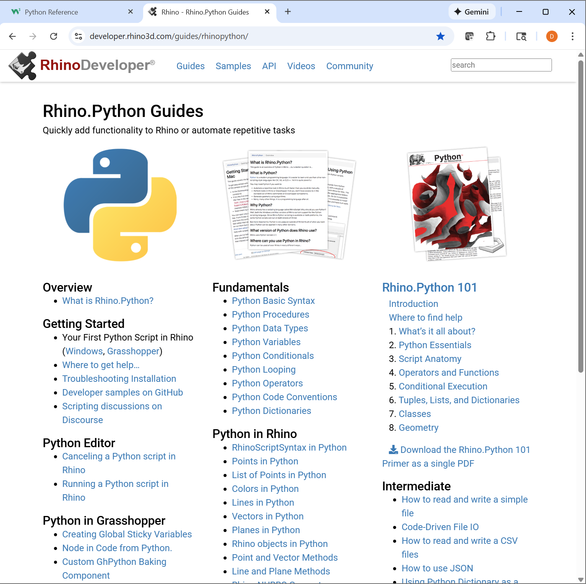
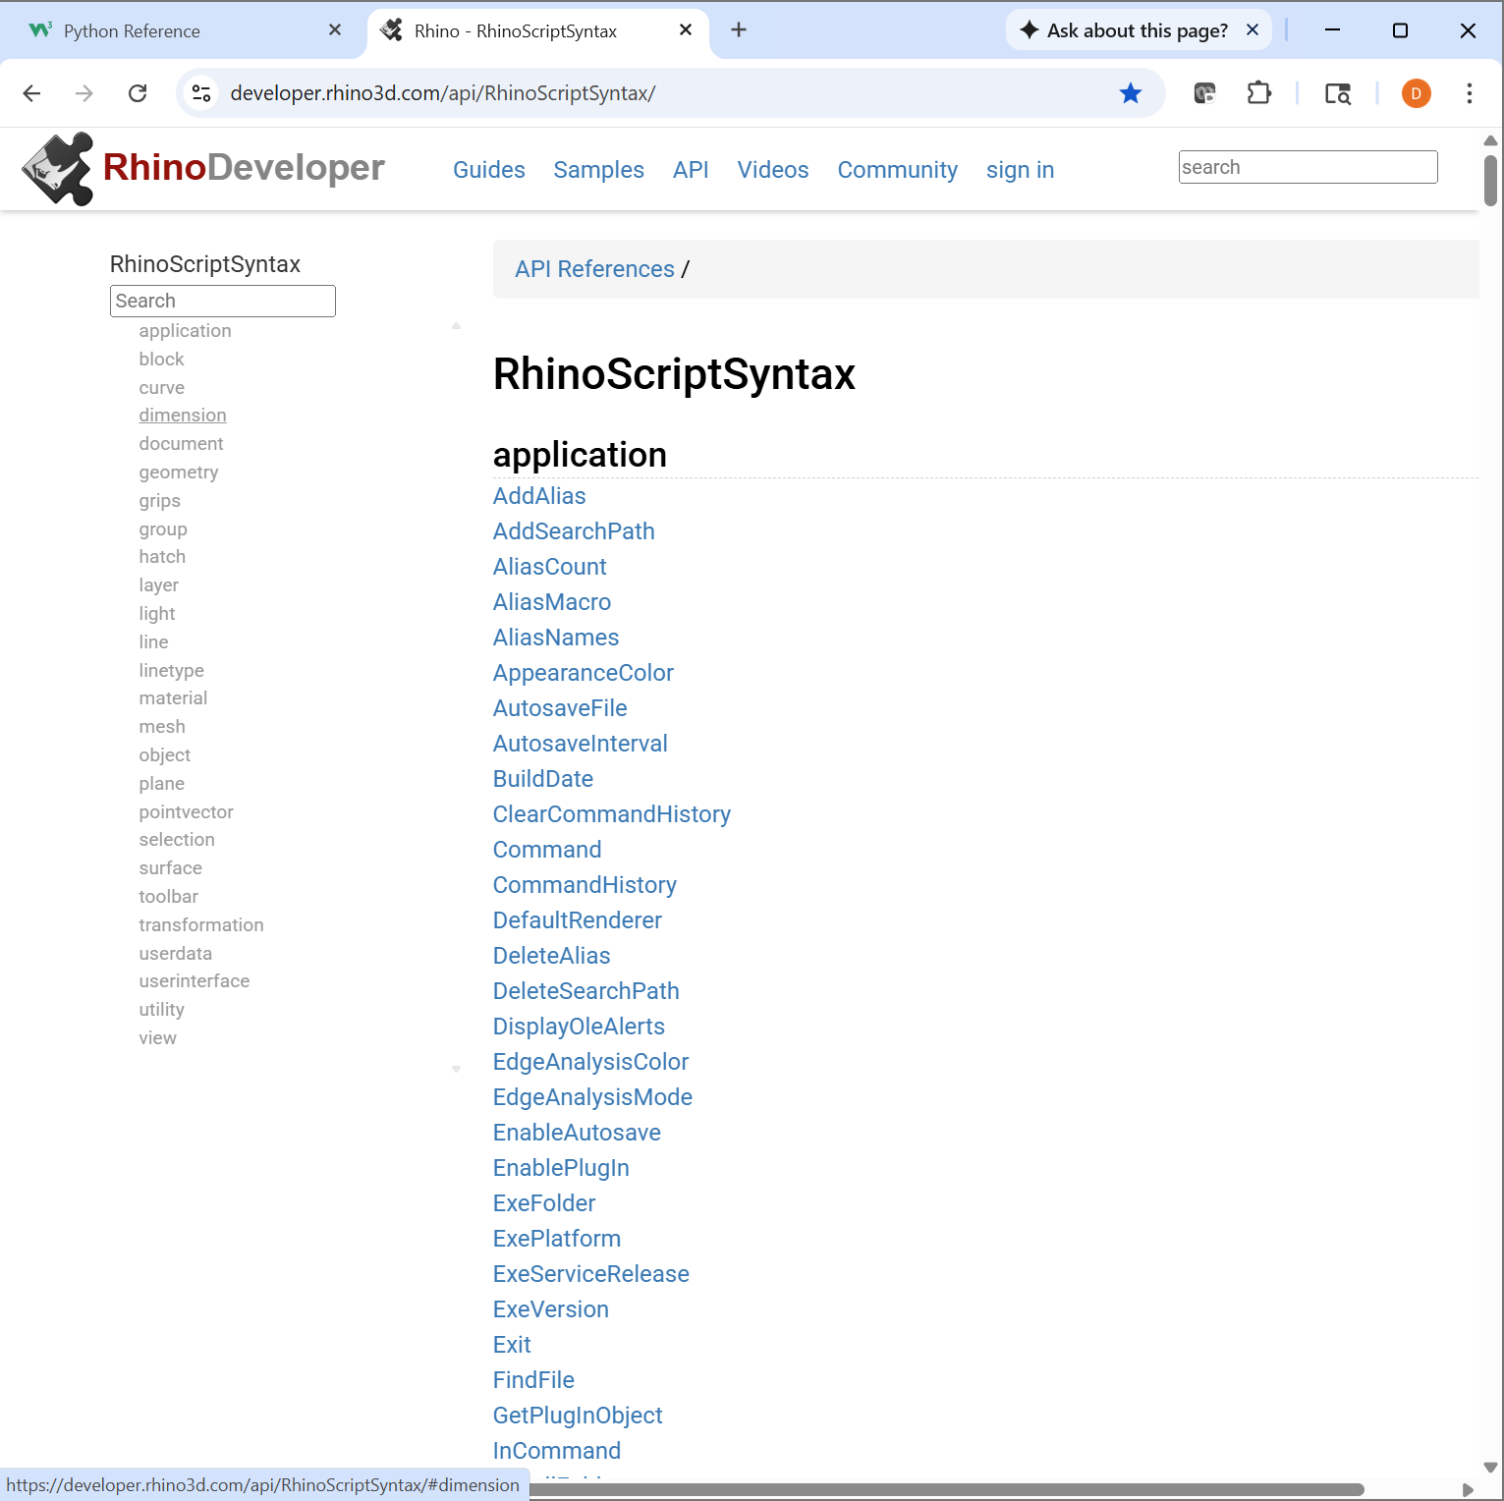
Rhino Python
https://developer.rhino3d.com/guides/rhinopython/
https://developer.rhino3d.com/api/RhinoScriptSyntax/

Slide 4
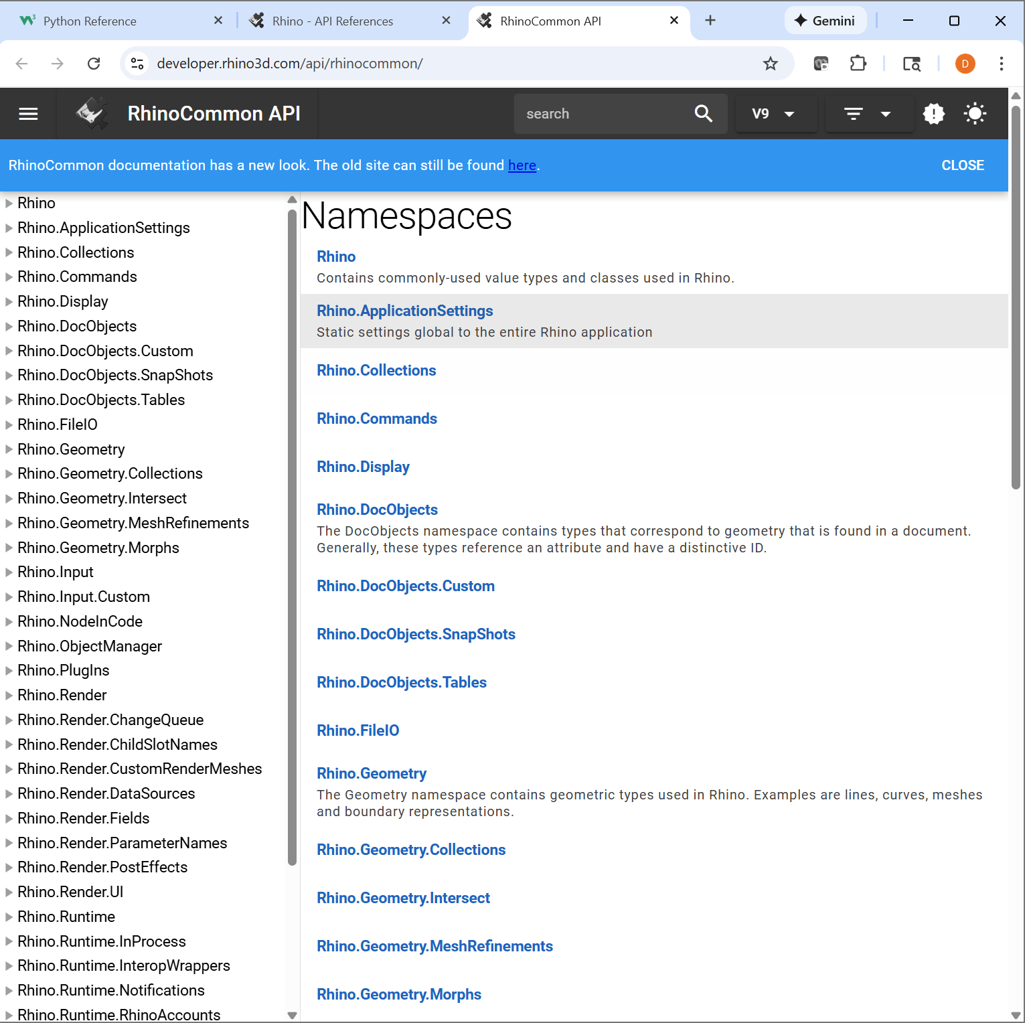
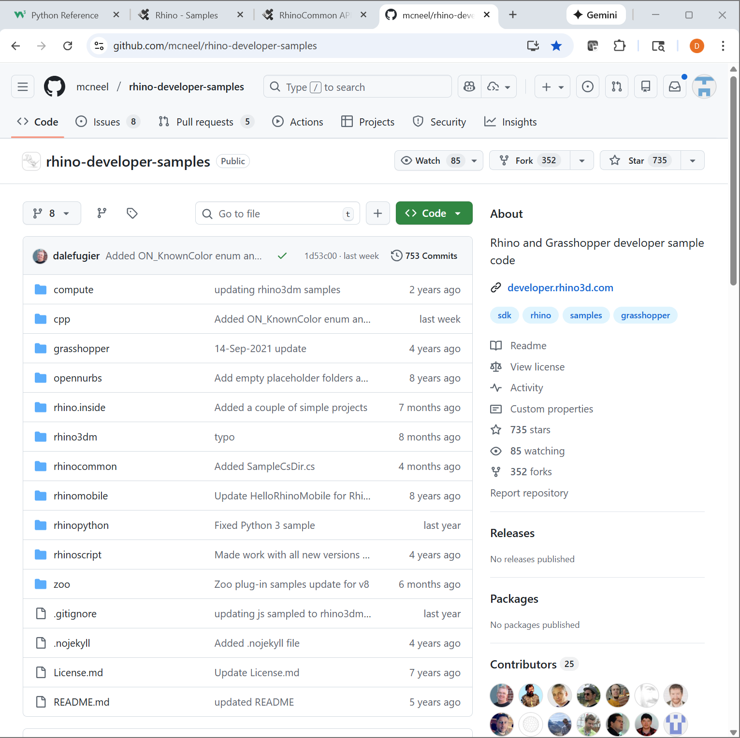
Rhino Python
https://developer.rhino3d.com/api/rhinocommon/
https://github.com/mcneel/rhino-developer-samples

Slide 5
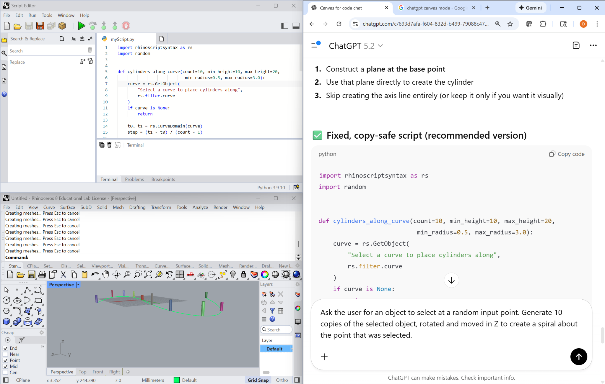
Setup

Slide 6

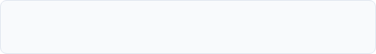
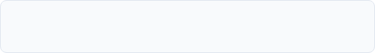


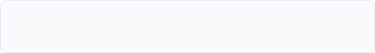




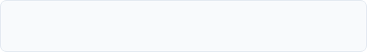
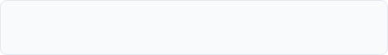



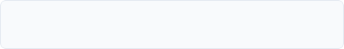


Core Functionality Overview
01
User Input & Selection
06
Topology & Booleans
02
Geometry Creation
07
Math & Vectors
03
Object Manipulation
08
Viewport Control
04
Object Attributes
09
Document Management
05
Analysis
10
User Interface

Slide 7

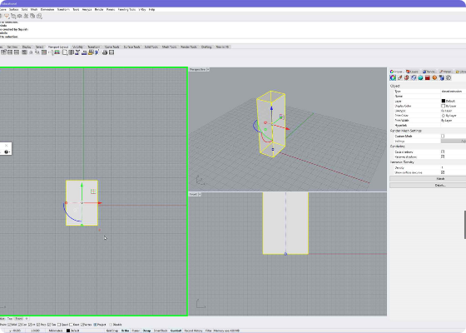
1. User Input & Selection
Scripts need context. We start by asking the user to provide information.
Vibe Prompt
"Write a script that asks me to click a location in the viewport, and then creates a Text Dot there that says 'You clicked here!'."

Slide 8

1. User Input & Selection
import rhinoscriptsyntax as rs
# Prompt: Ask user to click a location
point = rs.GetPoint("Click somewhere in the viewport")
if point:
# Prompt: Add a text dot at that location
rs.AddTextDot("You clicked here!", point)
print("Point captured.")
Core Functions
𝑓 rs.GetObject()
𝑓 rs.GetObjects()
𝑓 rs.GetPoint()
𝑓 rs.GetString()
𝑓 rs.GetInteger()
𝑓 rs.GetReal()
𝑓 rs.GetLayer()

Slide 9
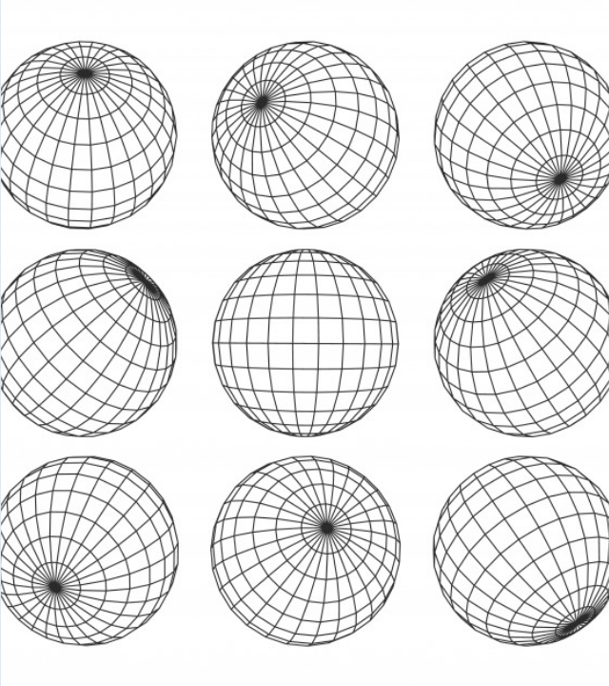
2. Geometry Creation
The core of generative design is creating new objects from scratch.
Vibe Prompt
"Generate 10 random spheres with varying radii scattered within a 20x20x5 unit area."

Slide 10
2. Geometry Creation
import rhinoscriptsyntax as rs
import random
# Prompt: Create 10 random spheres
for i in range(10):
x = random.uniform(0, 20)
y = random.uniform(0, 20)
z = random.uniform(0, 5)
center = [x, y, z]
radius = random.uniform(0.5, 2.0)
rs.AddSphere(center, radius)
Core Functions
𝑓 rs.AddLine()
𝑓 rs.AddCircle()
𝑓 rs.AddSphere()
𝑓 rs.AddPoint()
𝑓 rs.AddPolyline()
𝑓 rs.AddNurbsCurve()
𝑓 rs.AddText()

Slide 11

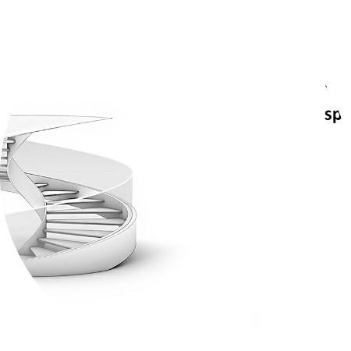
3. Object Manipulation
We transform objects to create arrays and iterative structures.
Vibe Prompt
"Take the selected object and create a spiral tower by copying, moving, and rotating it upwards 10 times."

Slide 12
3. Object Manipulation
import rhinoscriptsyntax as rs
obj = rs.GetObject("Select object to tower")
if obj:
# Prompt: Copy, Move, Rotate 10 times
for i in range(1, 11):
new_obj = rs.CopyObject(obj)
# Move up (z) and rotate
move_vec = [0, 0, i * 2]
rs.MoveObject(new_obj, move_vec)
rs.RotateObject(new_obj, [0,0,0], i * 15)
Core Functions
𝑓 rs.MoveObject()
𝑓 rs.CopyObject()
𝑓 rs.RotateObject()
𝑓 rs.ScaleObject()
𝑓 rs.MirrorObject()
𝑓 rs.OrientObject()

Slide 13
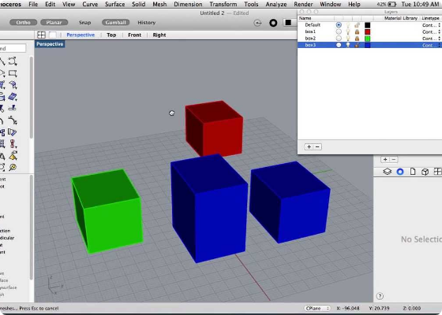
4. Object Attributes
Control the metadata: Name, Color, and Layer.
Vibe Prompt
"Rename the selected object to 'MySpecialObject' and change its display color to Electric Blue."

Slide 14
4. Object Attributes
import rhinoscriptsyntax as rs
import System.Drawing.Color
obj = rs.GetObject("Pick an object to paint")
if obj:
# Prompt: Change name
rs.ObjectName(obj, "MySpecialObject")
# Prompt: Change color to Electric Blue
color = System.Drawing.Color.FromArgb(0, 120, 255)
rs.ObjectColor(obj, color)
Core Functions
𝑓 rs.ObjectLayer()
𝑓 rs.ObjectColor()
𝑓 rs.ObjectName()
𝑓 rs.IsObjectHidden()
𝑓 rs.ObjectMaterialIndex()
𝑓 rs.MatchObjectAttributes()

Slide 15
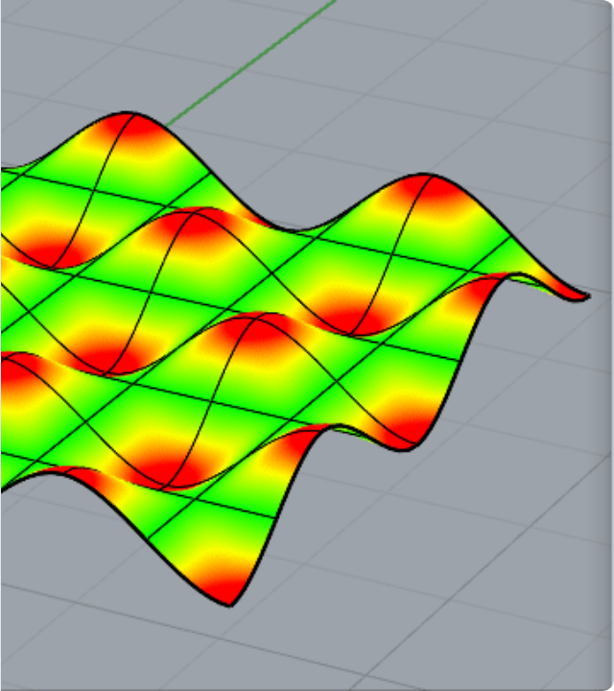
5. Analysis
Ask geometry for data to drive design decisions.
Vibe Prompt
"Analyze the selected curve and print its total length and whether it forms a closed loop."

Slide 16

5. Analysis
Core Functions
import rhinoscriptsyntax as rs
crv = rs.GetObject("Select curve", rs.filter.curve)
if crv:
# Prompt: Measure length
length = rs.CurveLength(crv)
# Prompt: Check if closed
is_closed = rs.IsCurveClosed(crv)
print(f"Length: {length:.2f}")
print(f"Closed Loop: {is_closed}")
𝑓 rs.CurveLength()
𝑓 rs.SurfaceArea()
𝑓 rs.Distance()
𝑓 rs.CurveClosestPoint()
𝑓 rs.IsCurveClosed()
𝑓 rs.SurfaceNormalAtUV()

Slide 17
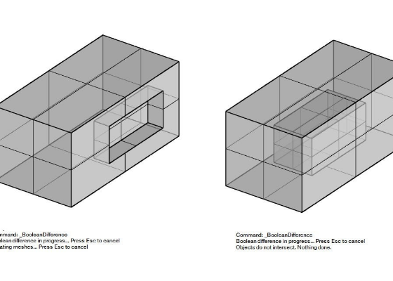
6. Topology & Booleans
Combine shapes to create complex forms.
Vibe Prompt
"Create two overlapping circles and merge them into a single boundary using a Boolean Union operation."

Slide 18

6. Topology & Booleans
Core Functions
import rhinoscriptsyntax as rs
# Create two overlapping circles
c1 = rs.AddCircle([0,0,0], 10)
c2 = rs.AddCircle([10,0,0], 10)
# Prompt: Merge them into one shape
result = rs.CurveBooleanUnion([c1, c2])
if result:
rs.DeleteObjects([c1, c2]) # Cleanup originals
print("Curves merged successfully.")
𝑓 rs.BooleanUnion()
𝑓 rs.BooleanDifference()
𝑓 rs.TrimCurve()
𝑓 rs.JoinCurves()
𝑓 rs.ExplodePolysurfaces()
𝑓 rs.SplitBrep()

Slide 19
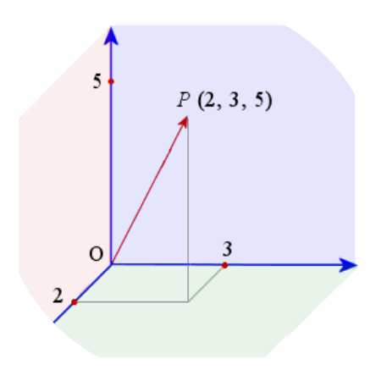
7. Math & Vectors
Calculate 3D data without drawing helper lines.
Vibe Prompt
"Calculate the vector and precise distance between two points clicked by the user."

Slide 20

7. Math & Vectors
Core Functions
import rhinoscriptsyntax as rs
pt_a = rs.GetPoint("Point A")
pt_b = rs.GetPoint("Point B")
if pt_a and pt_b:
# Prompt: Create vector from A to B
vec = rs.VectorCreate(pt_b, pt_a)
# Prompt: Get distance (Length)
dist = rs.VectorLength(vec)
print(f"Vector: {vec}")
print(f"Distance: {dist}")
𝑓 rs.VectorAdd()
𝑓 rs.VectorSubtract()
𝑓 rs.VectorCreate()
𝑓 rs.VectorScale()
𝑓 rs.VectorLength()
𝑓 rs.Distance()

Slide 21
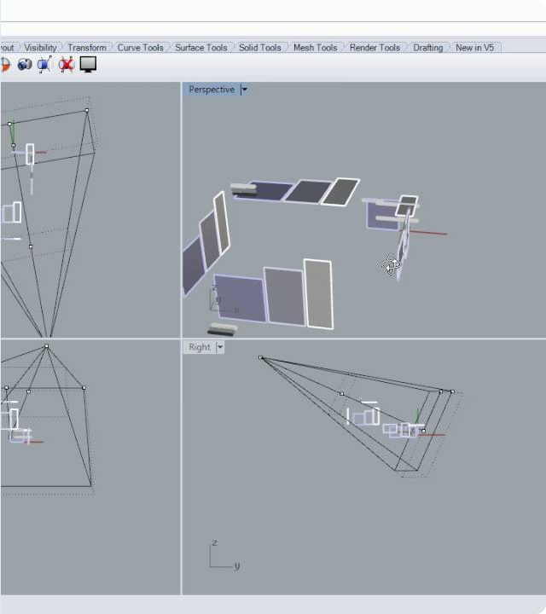
8. Viewport Control
Control the camera to automate presentations.
Vibe Prompt
"Create a turntable animation by rotating the current view 360 degrees in small 2-degree increments."

Slide 22

8. Viewport Control
Core Functions
import rhinoscriptsyntax as rs
import time
view = rs.CurrentView()
rs.ZoomExtents(view)
# Prompt: Rotate view 72 times * 5 deg = 360
for i in range(0, 72):
rs.RotateView(view, 2, 5.0)
rs.Sleep(50) # Pause 50ms
𝑓 rs.CurrentView()
𝑓 rs.ZoomExtents()
𝑓 rs.ViewCamera()
𝑓 rs.ViewTarget()
𝑓 rs.RotateView()
𝑓 rs.MaximizeRestoreView()

Slide 23
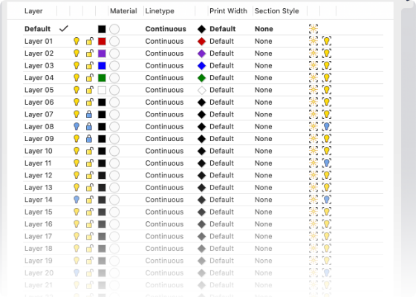
9. Document Management
Automate layer creation and project structure.
Vibe Prompt
"Create a new red layer named 'Scripted_Layer' and make it the active layer."

Slide 24

9. Document Management
Core Functions
import rhinoscriptsyntax as rs
# Prompt: Create new Red layer
layer_name = "Scripted_Layer"
new_layer = rs.AddLayer(layer_name, 255, 0, 0)
if new_layer:
# Prompt: Make it active
rs.CurrentLayer(new_layer)
print(f"Switched to {layer_name}")
𝑓 rs.AddLayer()
𝑓 rs.CurrentLayer()
𝑓 rs.LayerColor()
𝑓 rs.DeleteLayer()
𝑓 rs.AddGroup()
𝑓 rs.AddBlock()

Slide 25
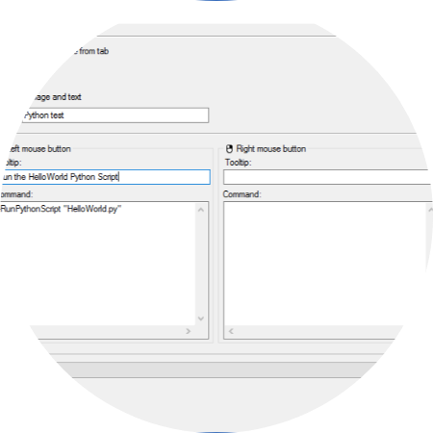
10. User Interface
Interact with the user via dialog boxes.
Vibe Prompt
"Display a popup list with three options ('A', 'B', 'C') and show a message box confirming the user's choice."

Slide 26

10. User Interface
Core Functions
import rhinoscriptsyntax as rs
options = ["Option A", "Option B", "Option C"]
# Prompt: Show ListBox
result = rs.ListBox(options, "Choose wisely", "My Tool")
if result:
# Prompt: Show MessageBox
rs.MessageBox(f"You picked {result}")
else:
print("Cancelled")
𝑓 rs.MessageBox()
𝑓 rs.ListBox()
𝑓 rs.ComboListBox()
𝑓 rs.PopupMenu()
𝑓 rs.HtmlBox()
𝑓 rs.GetColor()

